Slide 1
Functional Programming
As software becomes more and more complex, it is more and more
important to structure it well.
Well-structured software is easy to write and to debug, and provides a collection of modules that can be reused to reduce
future programming costs.
Map-Reduce has its roots in functional programming, which is exampled in languages such as Lisp and ML.

Slide 2
Functional Programming
Examples
// Regular Style Integer timesTwo(Integer i) { return i * 2; }
// Functional Style F<Integer, Integer> timesTwo = new F<Integer, Integer>() { public Integer f(Integer i) { return i * 2; } }

Slide 3
Functional Programming
A key feature of functional languages is the concept of higher order functions, or functions that can accept other functions as arguments.
// Regular Style List<Integer> oneUp = new ArrayList<Integer>(); for (Integer i: ints) oneUp.add(plusOne(i)); // Functional Style List<Integer> oneUp = ints.map(plusOne);

Slide 4
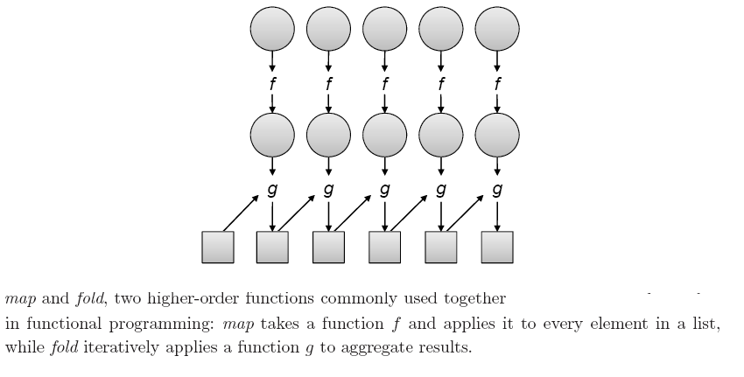
Functional Programming Two common built-in higher order functions are map and fold.

Slide 5
First class Function
First-class function values: the ability of functions to return newly constructed functions
F<Integer, Integer> timesTwo = new F<Integer, Integer>() { public Integer f(Integer i) { return i * 2; } }

Slide 6
Functional Programming
Functional programming is a declarative programming paradigm
Computation is more implicit (suggested but not communicated directly ) and functional call is the only form of explicit control
Many (commercial) applications exist for functional programming:
Symbolic data manipulation
Natural language processing
Artificial intelligence
Automatic theorem proving and computer algebra
Algorithmic optimization of programs written in pure functional languages (e.g Map-reduce)

Slide 7
Functional programming languages are Compiled and/or interpreted
Have simple syntax Use garbage collection for memory management
Are statically scoped or dynamically scoped
Use higher-order functions and subroutine closures
Use first-class function values
Depend heavily on polymorphism

Slide 8
Origin of Functional Programming
Church’s thesis:
All models of computation are equally powerful and can compute any function
Turing’s model of computation: Turing machine Reading/writing of values on an infinite tape by a finite state machine
Church’s model of computation: lambda calculus
This inspired functional programming as a concrete implementation of lambda calculus.
Computability theory:
A program can be viewed as a constructive proof that some mathematical object with a desired property exists
A function is a mapping from inputs to output objects and computes output objects from appropriate inputs

Slide 9
Concepts of Functional Programming
Functional programming defines the outputs of a program as mathematical function of the inputs with no notion of internal state (no side effects )
A pure function can always be counted on to return the same results for the same input parameters
No assignments: dangling and/or uninitialized pointer references do not occur
Example pure functional programming languages: Miranda , Haskell , and Sisal
Non-pure functional programming languages include imperative features with side effects that affect global state (e.g. through destructive assignments to global variables) Example: Lisp , Scheme , and ML.

Slide 10
Useful features in functional languages
Useful features are found in functional languages that are often missing in imperative languages:
First-class function values: the ability of functions to return newly constructed functions
Higher-order functions : functions that take other functions as input parameters or return functions.
Polymorphism: the ability to write functions that operate on more than one type of data.
constructs for constructing structured objects: the ability to specify a structured object in-line, e.g. a complete list or record value.
Garbage collection for memory management.

Slide 11
LISP
Lisp
Lisp (LIST Processing language) was the original functional language
Lisp and dialects are still the most widely used Simple and elegant design of Lisp:
Homogeneity of programs and data: a Lisp program is a list and can be manipulated in Lisp as a list.
Self-definition: a Lisp interpreter can be written in Lisp
Interactive: interaction with user through "read-eval-print“ loop

Slide 12
Data Structures
LISP & Scheme
The only data structures in Lisp and Scheme are atoms and lists Atoms are:
Numbers, e.g. 7
Strings, e.g. "abc"
Identifier Names (variables), e.g. x
Boolean values true #t and false #f
Symbols which are quoted identifiers which will not be evaluated, e.g. ’y
Input: a
Output: Error: unbound variable a
Input: ’a
Output: a

Slide 13
Data Structures
Lists:
To distinguish list data structures from expressions that are
written as lists, a quote (’) is used to quote the list:
’(elt1 elt2 elt3 ...)
Input: ’(3 4 5)
Output: (3 4 5)
Input: ’(a 6 (x y) "s")
Output: (a 6 (x y) "s")
Input: ’(a (+ 3 4))
Output: (a (+ 3 4))
Input: ’()
Output: () -------------------------Empty list

Slide 14
Primitive List Operations
car returns the head (first element) of a list
Input: (car ’(2 3 4)) Output: 2
cdr (pronounced "coulder") returns the tail of a list (list without the head)
Input: (cdr ’(2 3 4)) Output: (3 4)
cons joins an element and a list to construct a new list
Input: (cons 2 ’(3 4)) Output: (2 3 4)
Examples:
Input: (car ’(2)) Output: 2
Input: (car ’()) Output: Error
Input: (cdr ’(2 3)) Output: (3)
Input: (cdr (cdr ’(2 3 4))) Output: (4)
Input: (cdr ’(2)) Output: ()
Input: (cons 2 ’()) Output: (2)

Slide 15
If-Then-Else
Special forms resemble functions but have special evaluation rules
A conditional expression in Scheme is written using the if
special form: (if condition thenexpr elseexpr)
Input: (if #t 1 2) Output: 1
Input: (if #f 1 "a") Output: "a“
Input: (if (> 1 2) "yes" "no") Output: "no"
A more general if-then-else can be written using the cond special form:
where the condition value pairs is a list of (cond value) pairs and the condition of the last pair can be else to return a default value
Input: (cond ((< 1 2) 1) ((>= 1 2) 2)) Output: 1
Input: (cond ((< 2 1) 1) ((= 2 1) 2) (else 3)) Output: 3

Slide 16
Lambda Abstraction
A Scheme lambda abstraction is a nameless function specified with the lambda special form:
(lambda formal-parameters function-body)
where the formal parameters are the function inputs and the function body is an expression that is the resulting value of the function
Examples:
(lambda (x) (* x x)) ; is a squaring function: x2
(lambda (a b) (sqrt (+ (* a a) (* b b)))) ; is a function:

Slide 17
Defining Global Functions in Scheme
A function is globally defined using the define special form: (define name function)
For example:
(define sqr (lambda (x) (* x x)) )
Input: (sqr 3) Output: 9
Input: (sqr (sqr 3)) Output: 81
(define hypot (lambda (a b) (sqrt (+ (* a a) (* b b)))))
Input: (hypot 3 4) Output: 5

Slide 18
I/O and Sequencing
“read-evaluate-print”
display prints a value Input: (display "Hello World!") Output: "Hello World!"
Input: (display (+ 2 3)) Output: 5
newline advances to a new line Input: (newline)
Example:
(begin
(display "Hello World!")
(newline)
(end)
)

Slide 19
Higher-Order Functions
A function is called a higher-order function (also called a functional form) if it takes a function as an argument or returns a newly constructed function as a result.
Scheme has several built-in higher-order functions, for example: apply takes a function and a list and applies the function with the elements of the list as arguments
Input: (apply ’+ ’(3 4)) Output: 7
Input: (apply (lambda (x) (* x x)) ’(3)) Output: 9
map takes a function and a list and returns a list after applying the function to each element of the list
Input: (map (lambda (x) (* x x)) ’(1 2 3 4)) Output: (1 4 9 16)
Here is a function that applies a function to an argument twice:
(define twice
(lambda (f n) (f (f n))))
Input: (twice sqrt 81) Output: 3
Input (fill 3 “a”) output (“a” “a” “a”)

Slide 20
Functional Programming Today
Significant improvements in theory and practice of functional programming have been made in recent years
Strongly typed (with type inference)
Modular
Imperative language features that are automatically translated to functional constructs (e.g. loops by recursion )
Improved efficiency
Remaining obstacles to functional programming:
Social: most programmers are trained in imperative programming
Commercial: not many libraries, not very portable, and no integrated development environments for functional languages

Slide 21
Assignment
What are the Beauties of functional programming?

